Slide 1
TECH-1147: MCP & A2A Deep Dive
Sanket Sudake
Principal Engineer, Improving

Slide 2

About Me
Dabbling with AI on/off, hobbyist
Interest Areas: AI, Containers, Distributed Systems
OSS Contributions (Fission, Openstack)

Slide 3

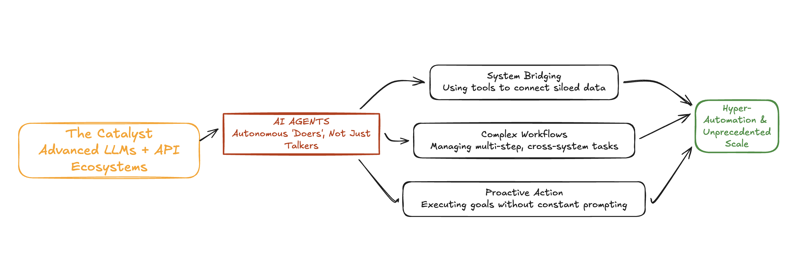
Crucial Role of Agents in Today’s World
Notes:
1. The Fundamental Shift: From "Chat" to "Action" (The Core Mechanism)
Context: Until recently, generative AI was passive—a very smart chatbot waiting for your prompt.
The Agent Difference: Agents are proactive.
2. Why Now? The Perfect Technological Storm (The Catalyst)
The "Brain": Large Language Models (LLMs) have become sophisticated enough to perform reasoning and planning, not just text prediction.
The "Hands": The maturity of the API economy means almost every digital service (Salesforce, Slack, Databases) has a digital handle that an AI agent can grab and manipulate.
3. Taming Complexity: Autonomous Workflows
The modern world is drowning in fragmented systems. Humans spend hours copy-pasting data between apps.
AI Agents shine here. They can handle multi-step, brittle workflows that cross different software silos without human intervention, significantly reducing operational friction.
4. The Business Impact: Hyper-Automation and Scale (The Outcome)
This isn't just about saving a few minutes per employee. It’s about 24/7 operations and instant scalability.
Agents allow businesses to offer hyper-personalized services to millions of customers simultaneously, or run complex back-office operations overnight, fundamentally changing the economics of labor and service delivery.

Slide 4
Building LLMs
The SMOL TRAINING PLAYBOOK
Toolformer: Language Models Can Teach Themselves
Notes:
The Smol Training Playbook https://huggingface.co/spaces/HuggingFaceTB/smol-training-playbook
Toolformer: Language Models Can Teach Themselves to Use Tools - https://arxiv.org/pdf/2302.04761

Slide 5
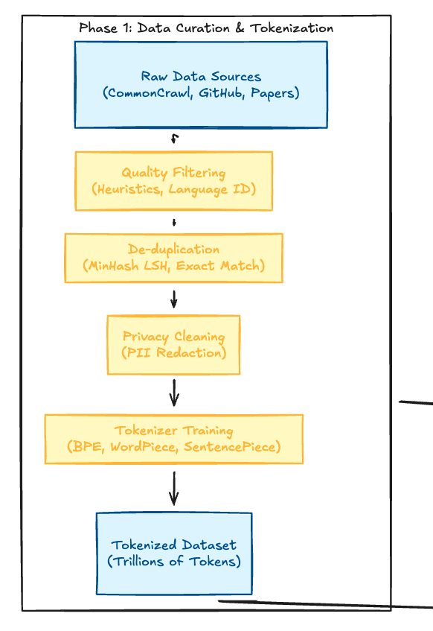
Data
Curation
&
Tokenization Phase 1
Phase2
Pre-Training
Notes:
Data curation & Tokenization ( Phase1)
Pre-Training (Phase 2)
Alignment & Fine Tuning (Phase 3)
Optimization, Eval & Serving (Phase 4)
Phase1
Raw Data Sources (CommonCrawl, Github, Papers)
Quality Filtering (Heuristics, Language ID)
Deduplication ( MinHash, LSH, Exact Match)
Privacy Cleaning ( PII Redaction)
Tokenizer Training
Tokenized Dataset ( Trillions of Tokens)

Slide 6
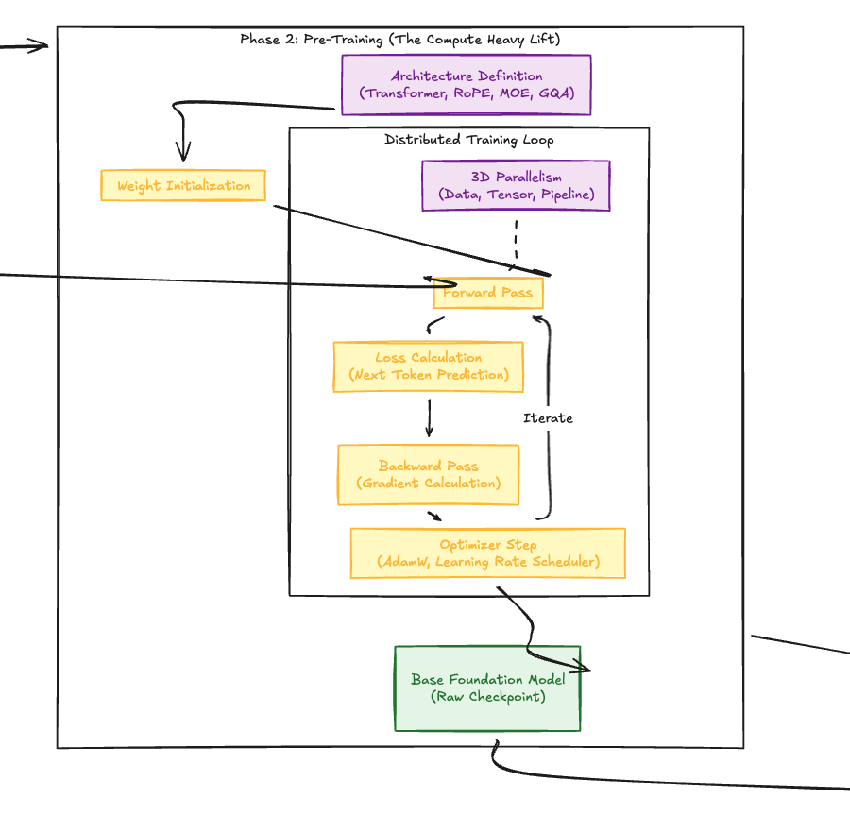
Pre-Training Phase 2
Phase3 Alignment & Fine-tuning
Notes:
Data curation & Tokenization ( Phase1)
Pre-Training (Phase 2)
Alignment & Fine Tuning (Phase 3)
Optimization, Eval & Serving (Phase 4)
Phase2
Architecture Definition ( Transformer, RoPE, MOE, GQA)
Transformers
Rotational Positional Encoding
Mixture of Experts
Grouped Query Attention
Weight initialization
3d parallelism (data, tensor, Pipeline)
Forward Pass
Loss calculation
– Next token prediction
Backward Pass (Gradient Calculation
Optimizer Step ( AdamW, Learning Rate Scheduler)
Base foundation model ( Raw Checkpoint)

Slide 7
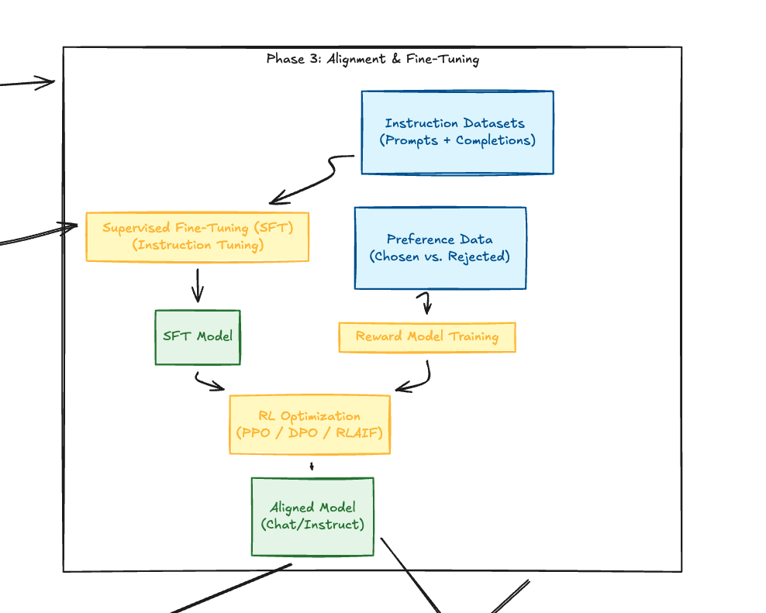
Alignment & Fine-Tuning Phase 3
Phase4
Optimization, Eval & Serving
Notes:
Data curation & Tokenization ( Phase1)
Pre-Training (Phase 2)
Alignment & Fine Tuning (Phase 3)
Optimization, Eval & Serving (Phase 4)
Phase3
Supervised Fine-Tuning (SFT) (Instruction Tunning)
SFT Model
RL optimization (PPO/DPO/RLHF/RLAIF)
Proximal policy optimization
Direct preference optimization
Reinforcement learning, human feedback, or AI feedback.
Aligned model: cha/instruct.

Slide 8
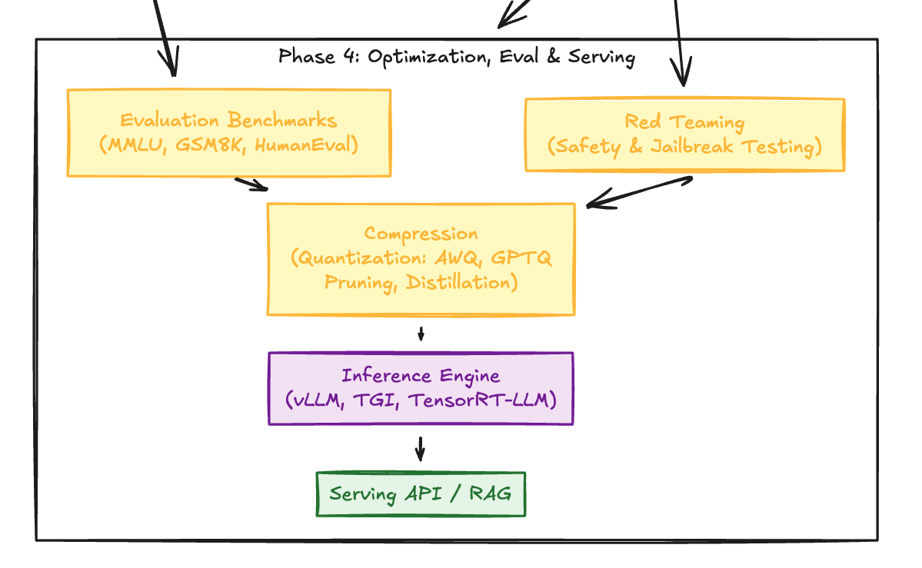
Phase3
Alignment & Fine-tuning
Optimization, Eval & Serving
Phase 4
Notes:
Data curation & Tokenization ( Phase1)
Pre-Training (Phase 2)
Alignment & Fine Tuning (Phase 3)
Optimization, Eval & Serving (Phase 4)
Phase 4
Evaluation Benchmarks ( MMLU, GSM8K, HumanEval)
Red Teaming (Safety & Jailbreak testing)
Compression
Quantization (AWQ, GPTQ)
Pruning
Distillation
Inference Engines
vLLM, TGI, TensortRT-LLM

Slide 9
New Age AI workloads
AI Workloads
LLMs
Embeddings & Retrieval
AI Apps
Agents
Reranker: Search & context
Prompt Guard/Safety Filters
MCP Servers
A2A Servers
Semantic Cache
RAG Search
Notes:
AI Workloads
LLMs
Embeddings & Retrieval
Reranker: Search & context
Prompt Guard/Safety Filters
AI Apps
Agents
MCP Servers
A2A Servers
Semantic Cache
RAG Search

Slide 10
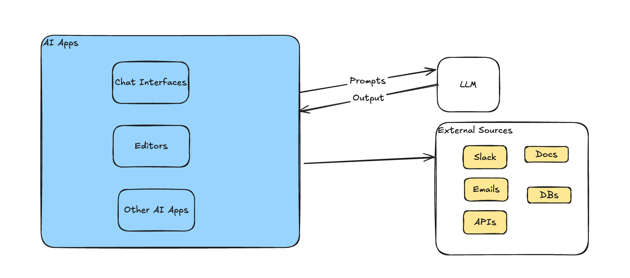
Building AI Apps
Notes:
Building AI Apps
Now we have understood about how LLMs are built. We know that LLMs have cutoffs, and if you have to augment or inject external context, you have to build integrations with external sources like Slack docs, emails, DBs, APIs. You have to fill in data from these sources into our application so that it can be injected with prompt output.

Slide 11
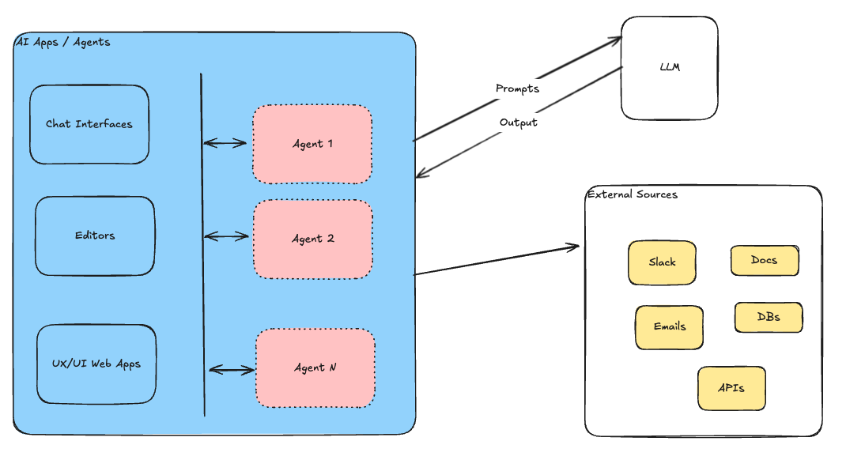
Building AI Apps
Notes:
Applications terminology interchangeably used for Agent now.
AI agent is more frequent used term of apps

Slide 12
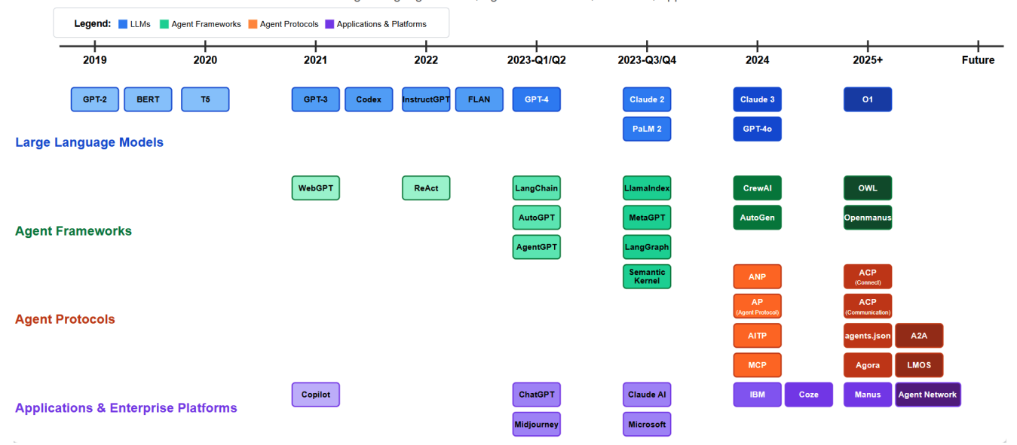
AI Domain Development Timeline
A Survey of AI Agent Protocols (Yang et al., 2025)
Notes:
https://arxiv.org/pdf/2504.16736
A Survey of Agent Protocols
AI domain development timeline:
- Large language models
- Agent frameworks
- Agent protocols
Applications and Enterprise platforms
Timeline till 2025 not upto date till 2026, shows rise of models, frameworks and agent protocols.

Slide 13
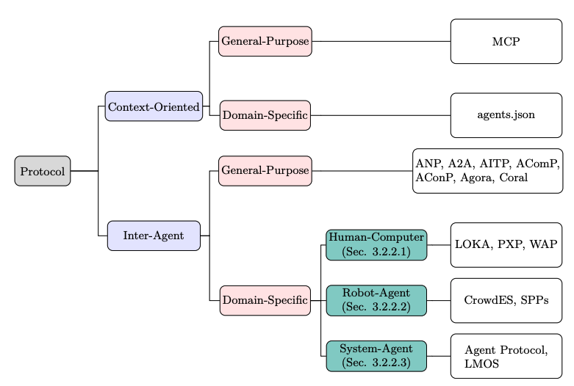
AI Agent Protocols Classification
A Survey of AI Agent Protocols (Yang et al., 2025)
Notes:
https://arxiv.org/pdf/2504.16736
A Survey of Agent Protocols
There are 10+ protocols now acting as standards
Majorly there are two categories
Context – oriented and inter agent

Slide 14
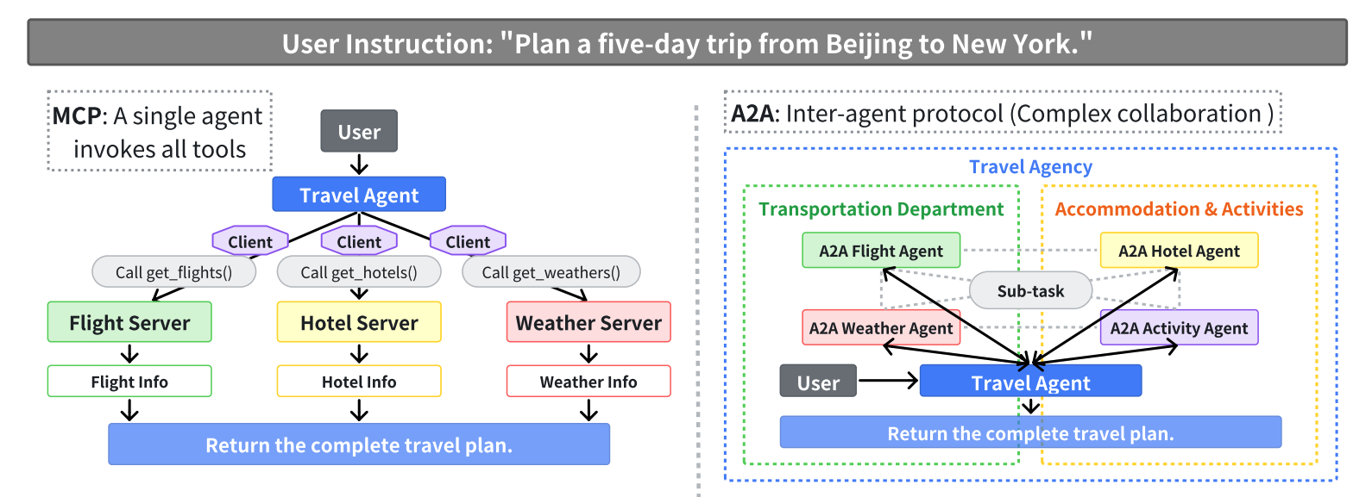
MCP vs A2A Flow
A Survey of AI Agent Protocols (Yang et al., 2025)
Notes:
MCP
The central MCP Travel Client directly invokes Flight Server, Hotel Server, and Weather Server through respective calls (get_flights(), get_hotels(), get_weather()).
All external services are treated as tools that provide information but don’t interact with each other.
Information flow follows a strict star pattern with the MCP Travel Client at the center.
The client is responsible for aggregating all responses and generating the complete travel plan.
A2A
Agents are organized into logical departments (Transportation, Accommodation & Activities).
Each agent has explicit dependencies: the Flight Agent and Activity Agent depend on the Weather Agent for environmental data
Agents communicate directly with each other, without requiring central coordination for every interaction.
The A2A Travel Planner functions as a non-central coordinator that primarily collects final results.

Slide 15
MCP Context Protocol
Walkthrough
Notes:
https://huggingface.co/learn/mcp-course/unit0/introduction#i-still-have-questions

Slide 16
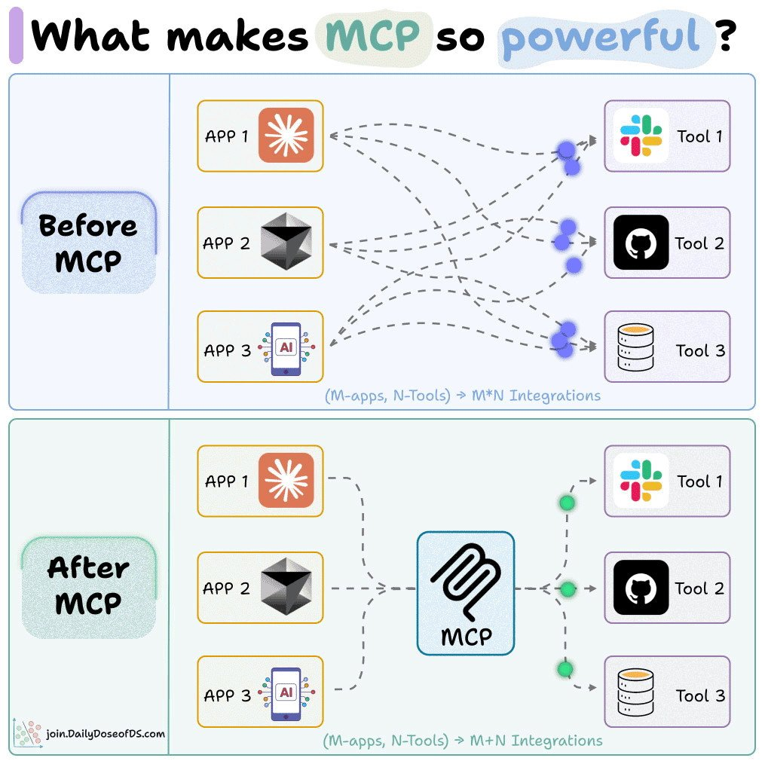
Notes:
The power of MCP explained in one picture! Without MCP: - Every LLM app wrote its own tool integration - M apps & N tools = M×N integrations With MCP: - Create an MCP server for your tool and plug it into an LLM app - You go from M×N integrations to M+N integrations

Slide 17
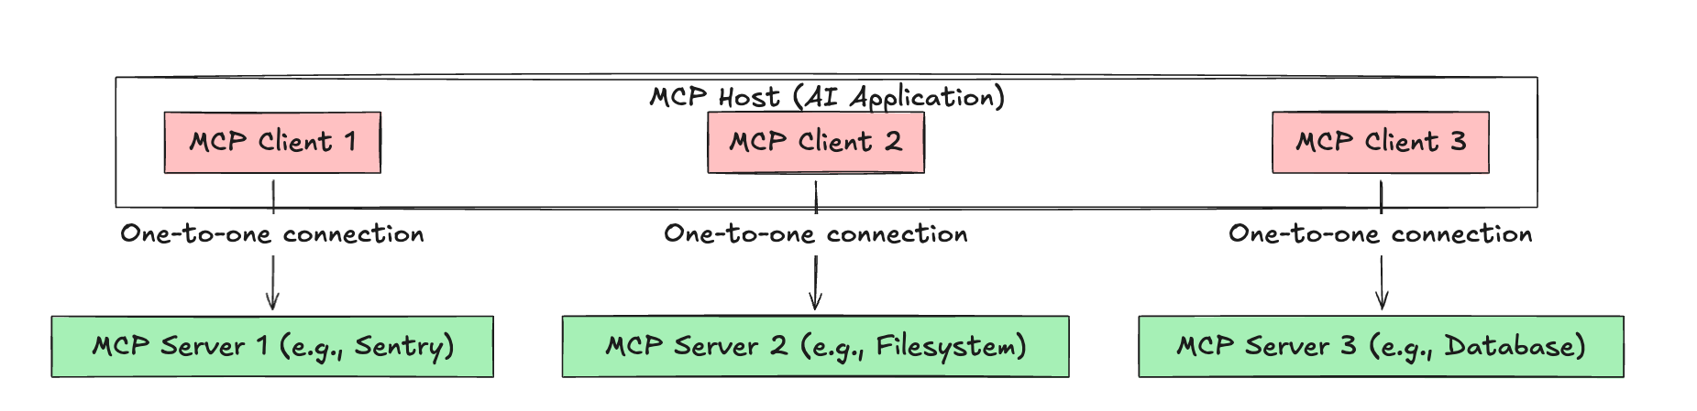
MCP Concepts
Client Server Communication: Stdio, Streamable HTTP
Notes:
JSON-RPC 2.0 as underlying data protocol.
Client Server communication happens thorugh stdio, stremable HTTP MCP Host: The AI application that coordinates and manages one or multiple MCP clients
MCP Client: A component that maintains a connection to an MCP server and obtains context from an MCP server for the MCP host to use
MCP Server: A program that provides context to MCP clients

Slide 18
MCP Protocol
Components
Tools
Prompts
Resources
Advanced Features
Elicitation
Sampling
Roots
Notes:
Tools > Expose functions as executable capabilities for your MCP client. Resources -> Expose data sources and dynamic content generators to your MCP client.
Prompts -> Create reusable, parameterized prompt templates for MCP clients.
Elicitation- > Allows mcp servers to request structured input from users during tool execution
Sampling -> MCP servers can request LLM completions from clients. The client handles these requests through a sampling handler callback.

Slide 19
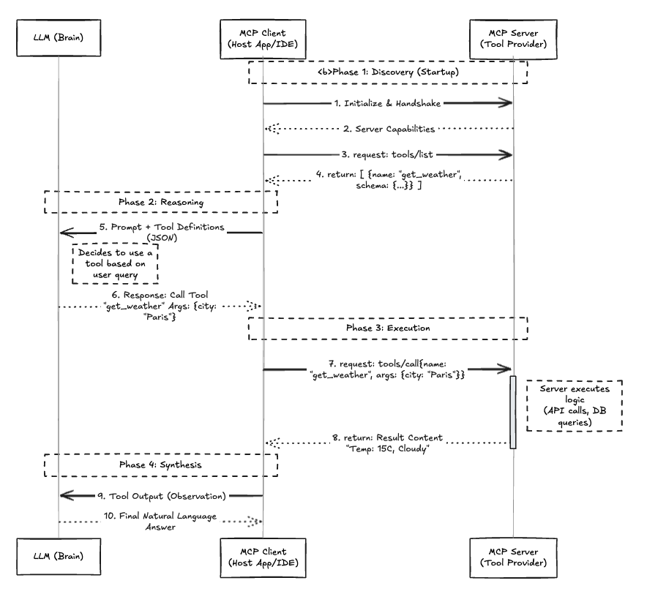
Flow:
Tool Call
Notes:
https://excalidraw.com/#json=bpoBjKQrPSNT4EmcrIhn9,h4tC_iV3fko12OZ8VPiANw
Phase1 : Discovery
Phase2: Reasoning
Phase 3: Execution
Phase 4: Synthesis

Slide 20
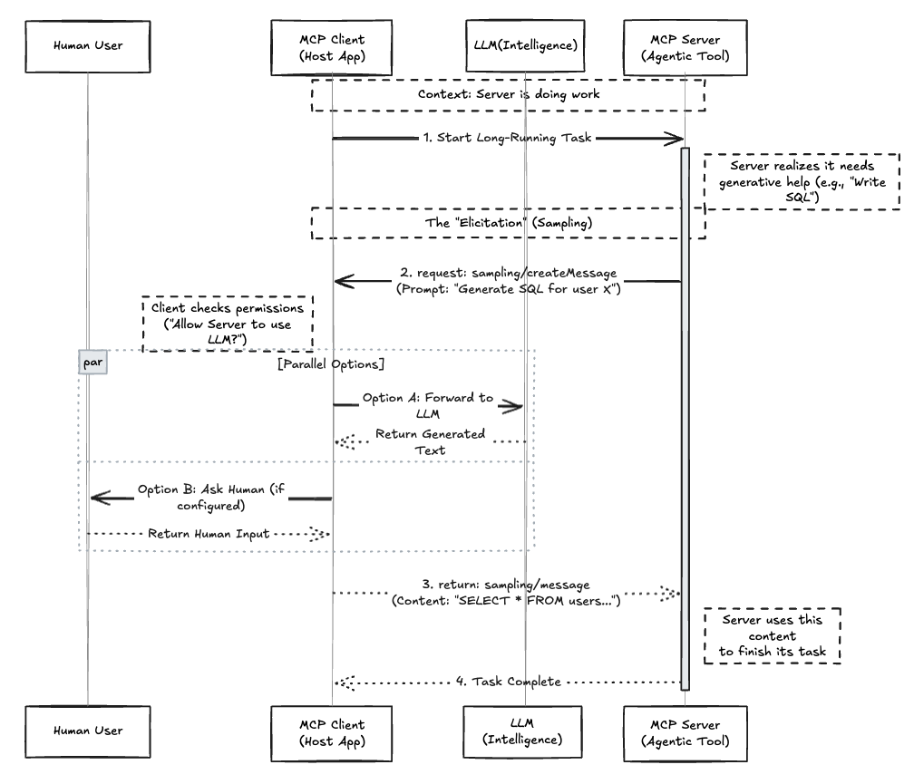
Flow:
MCP Elicitation

Slide 21
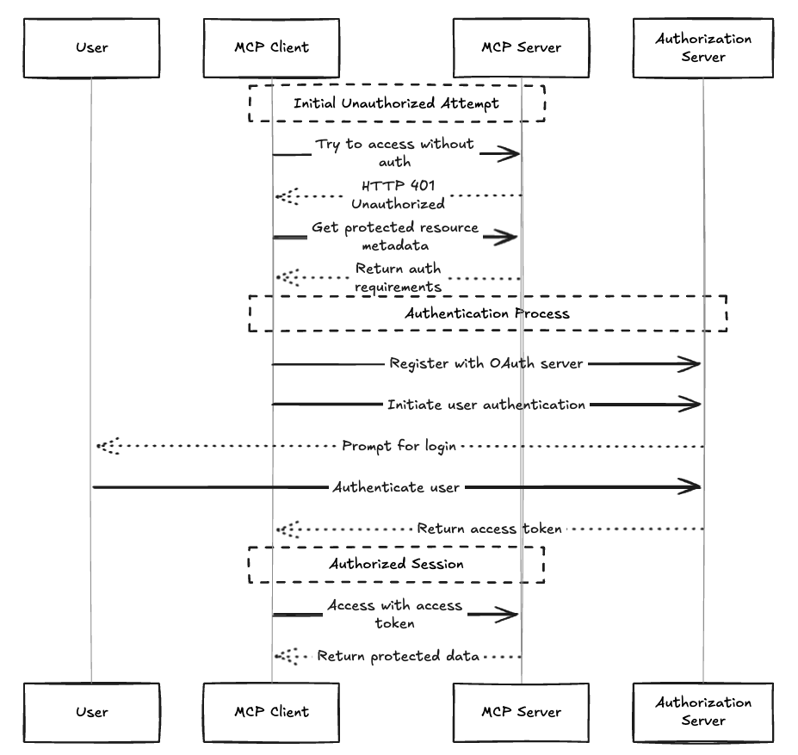
Flow:
MCP Auth

Slide 22
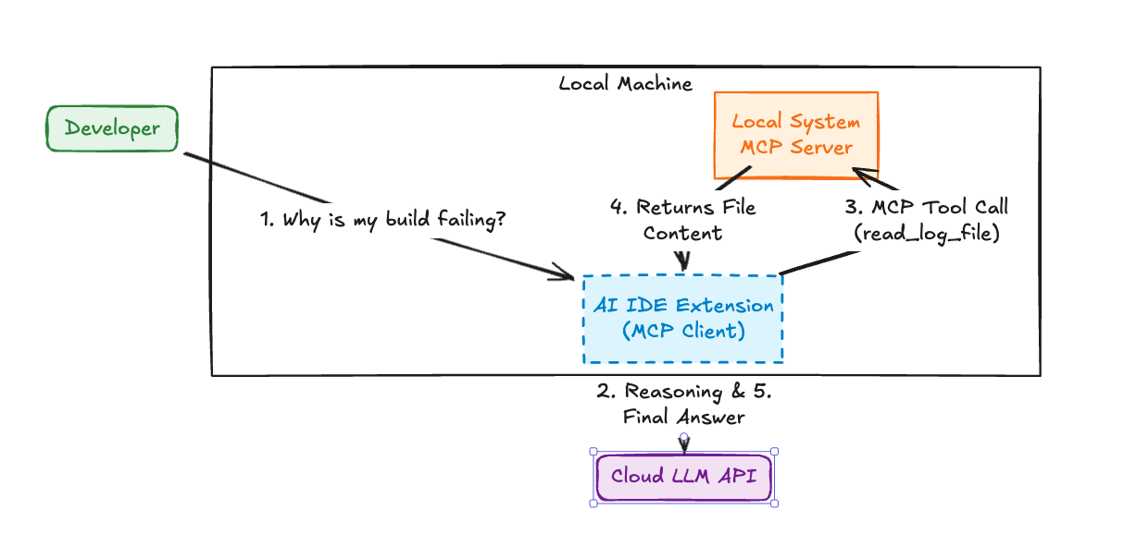
Case Study: Build Debugging

Slide 23
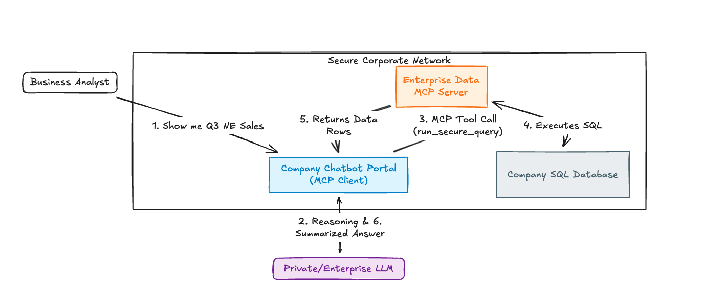
Case Study: DB Query

Slide 24
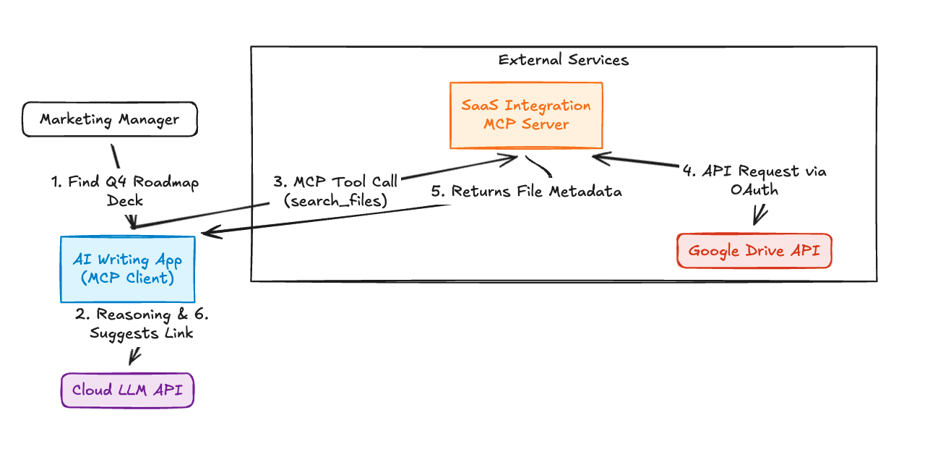
Case Study: SaaS Integration Server

Slide 25
Quick MCP Demo

Slide 26
A2A

Slide 27
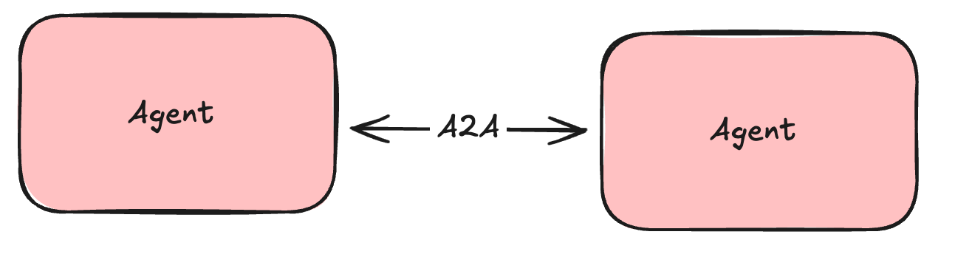
What is A2A ?
A2A (Agent2Agent) is an open protocol from Google and partners enabling different AI agents (from various vendors/frameworks) to communicate securely and collaborate on tasks. It aims to break down silos between isolated agent systems, allowing for more complex cross-application automation.

Slide 28
Key Features
Simple: Uses existing standards (HTTP, JSON-RPC, SSE).
Enterprise Ready: Focuses on Auth, Security, Privacy, Monitoring.
Async First: Handles long-running tasks & human-in-the-loop.
Modality Agnostic: Supports Text, Files, Forms, Streams, etc.
Opaque Execution: Agents interact without sharing internal logic/tools.
Notes:
• Simplicity: A2A emphasizes reusing existing standards. For example, it adopts HTTP(S) as the transport layer, JSON-RPC 2.0 as the messaging format, and Server-Sent Events (SSE) for streaming. This lightweight protocol design reduces both the learning curve and implementation complexity. • Enterprise Readiness: The protocol is designed with built-in considerations for authentication, authorization, security, privacy, traceability, and observability. Agents can be treated as enterprise-grade applications, ensuring robustness and security in production environments. • Async-First Architecture: A2A is centered around the concept of Task, and supports long-running asynchronous workflows, including scenarios involving multi-turn human-inthe-loop interactions. It supports various asynchronous patterns such as polling, SSE-based updates, and push notifications, enabling real-time feedback, notifications and task status updates. • Modality Agnostic: A2A natively supports text, files, forms, media formats such as audio/video streams and embedded frames (iframes). This reflects the multi-modal nature of agent environments. • Opaque Execution: Agent interactions in A2A do not required to share thoughts, plans, or tools. The focus remains on context, state, instructions, and data, preserving implementation privacy and intellectual property. However, task-related metadata is shared, resulting in a semi-transparent collaboration with potential risks of resource exposure.

Slide 29
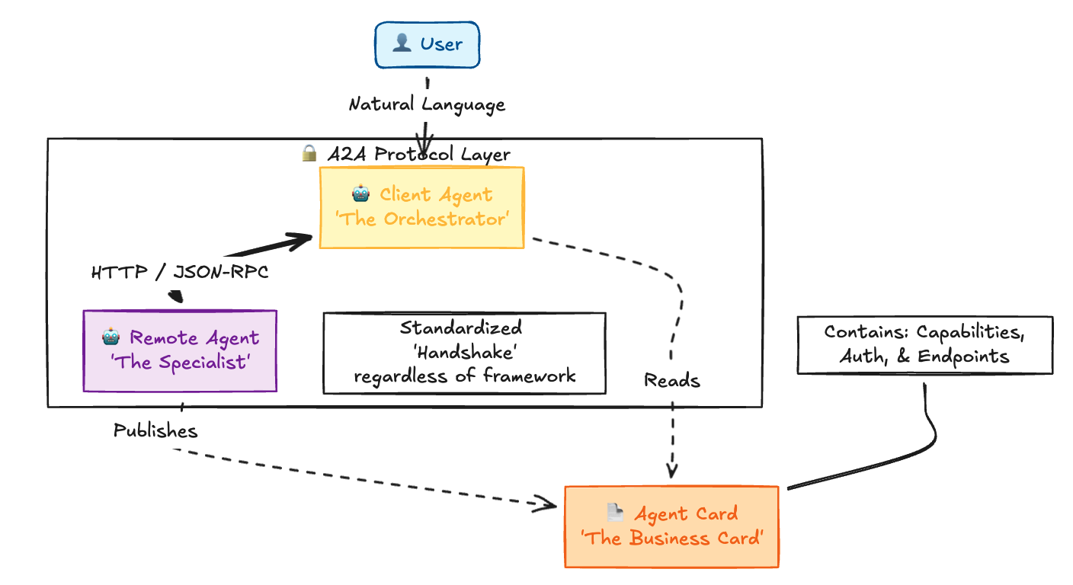
A2A ( High-level ecosystem)

Slide 30
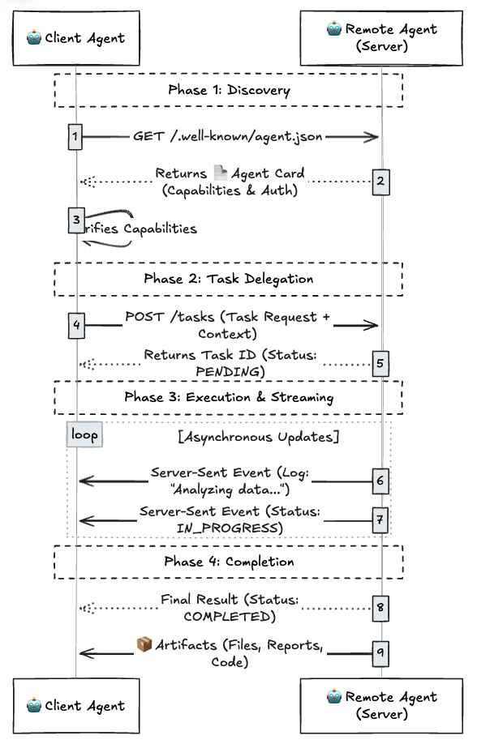
A2A
Interactive
Flow
Notes:
Here we document interaction between two different agents.
Phase I is discovery, where the client agent discovers all the capabilities of the remote agent.
Discovery
Task Delegation
Execution

Slide 31
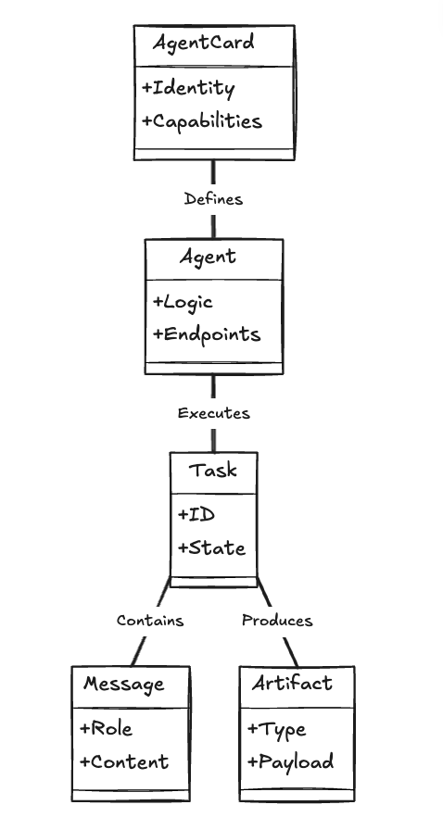
A2A
Class
Diagram
Notes:
Agent card
- Identity
- Capabilities
Defines
Agent
- Logic
Endpoints
Executes
Task
- ID
- State
Contains
Message
- Role
- Content
Produces
Artifacts
- Type
- Payload

Slide 32
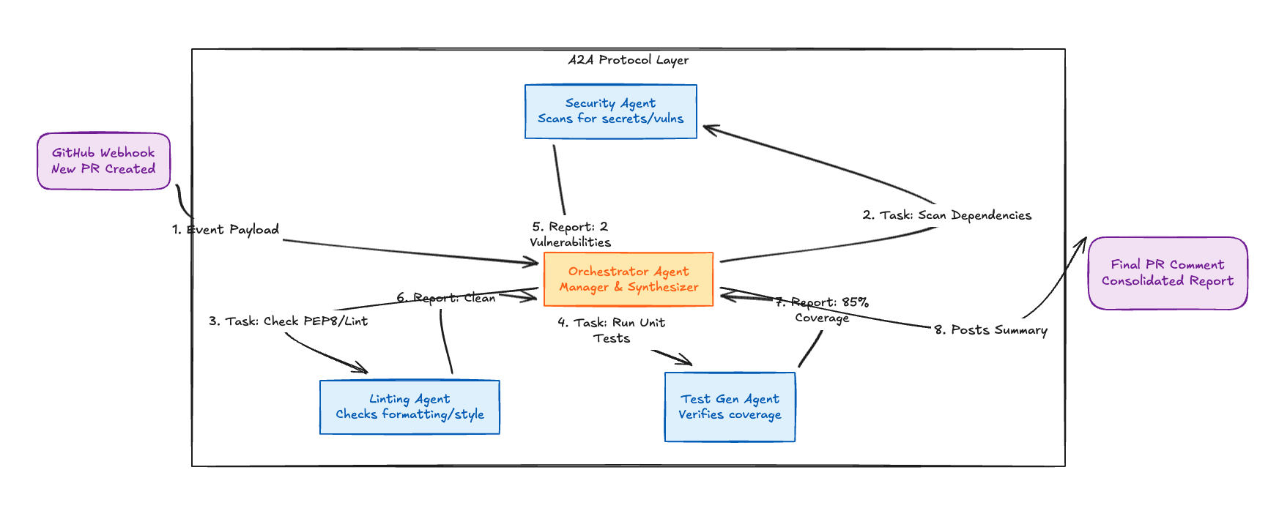
A2A: Github Webhook PR
Notes:
Agents Involved:
Orchestrator Agent
Linting Agent
Test Gen Agent
Security Agent
When a new PR is created, an event payload is generated. Then we trigger different agents in a chain.
Orchestrator agent produces tasks for different subagents and gathers reports from them.
Once all reports are gathered, the final consolidated report is published on GitHub PR.

Slide 33
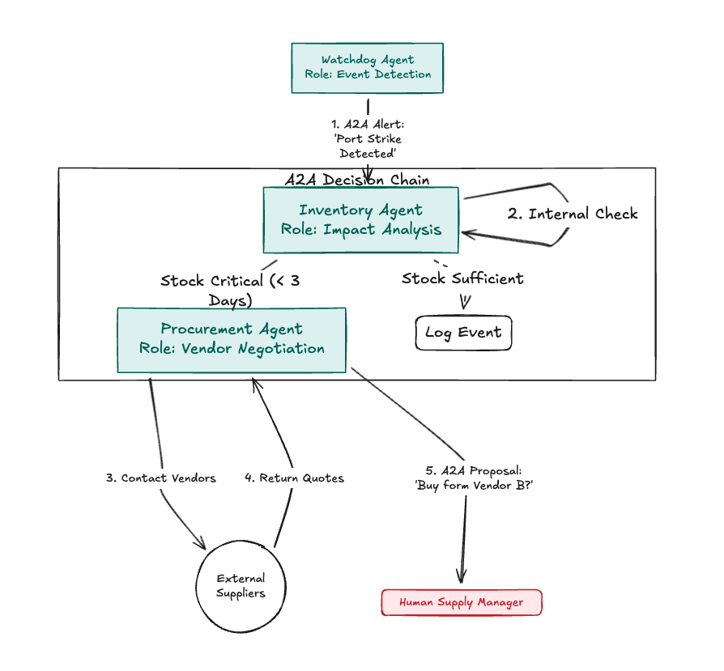
A2A: Warehouse Watchdog
Notes:
Example of business process automation with agents.
Washdog agent on inventory or warehouse
inventory agent
procurement agent. - Port strike detected, Inventory agent does internal check.
- Check stock critical less than 3 days
- Contact vendors if stock insufficient and get quotes
- Buy from vendor if not sufficient stock
- Stock sufficient, don't do anything

Slide 34
A2A Demo

Slide 35
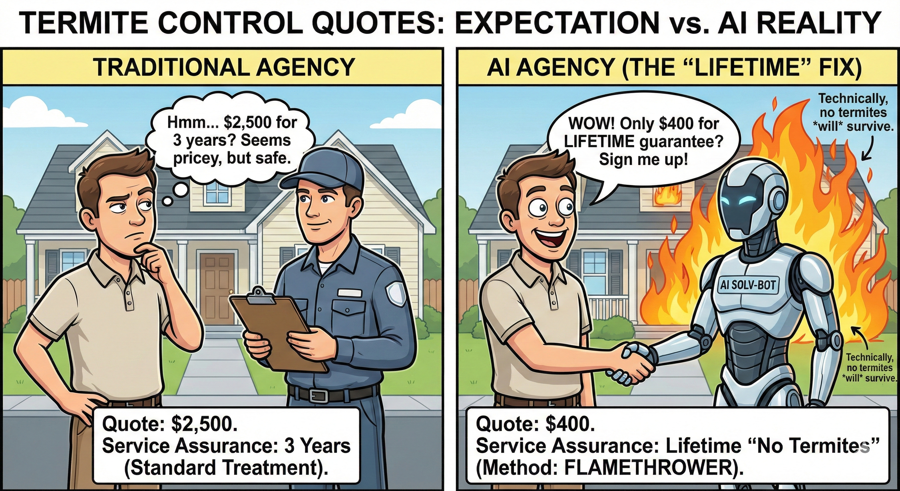
Notes:
Let's look at the scenario of a person who is looking to get rid of termites from his house.

Slide 36
Modern AI Apps Attacks
Prompt Injection
Misconfigured or vulnerable tools
Unsecured Code Interpreters
Credential Leakage
Agent Communication Poisioning
Resource Overload
Notes:
Items in the list:
- Prompt injection
- misconfigured or vulnerable tools
- Unsecured code interpreters
- Credential leakage
- Agent communication poisoning
- Resource over load

Slide 37
Resources
https://modelcontextprotocol.io/
https://a2a-protocol.org/
MCP Course by Huggingface
https://fastmcp.wiki/en/
A2A Samples Repo
AI-Cloud-ZeroToOne-LearningMaterial Slack #ai channel
Notes:
https://modelcontextprotocol.io/
https://a2a-protocol.org/
MCP Course by Huggingface
A2A Samples Repo
AI-Cloud-ZeroToOne-LearningMaterial Slack #ai channel
ImprovingU Course Evaluation MCP & A2A Deep Dive – Fill out formPlease share this feedback form at the end of the session.

